Slide 1

Automated Patient Education
PRESENTED BY:SRIVIDYA MS(1CR25CD058)
VAIBHAV RANJAN(1CR25CD062)
SYED AAUSAF(1CR25CD059)
FACULTY GUIDE:PROF SHANU
CMR INSTITUTE OF TECHNOLOGY
ACADEMIC YEAR:2025-2029

Slide 2
Empowering Patients, Transforming Healthcare (India)
In the evolving landscape of Indian healthcare, an automated patient education system emerges as a pivotal tool. This presentation outlines a comprehensive solution designed to bridge the knowledge gap, empower patients, and ultimately elevate healthcare outcomes across the nation.

Slide 3

The Challenge: Bridging the Healthcare Knowledge Gap
Complex Medical Information
Patients often struggle to comprehend intricate medical details, diagnoses, and treatment plans, leading to confusion and anxiety. eremedium.in
Poor Adherence & Outcomes
A lack of understanding frequently results in poor treatment adherence, adverse health outcomes, and a subsequent increase in healthcare costs. eremedium.in
Ineffective Traditional Methods
Outdated methods like paper pamphlets are largely ineffective in engaging patients and conveying critical health information. logicloom.in

Slide 4

Introducing: The Automated Patient Education System
AI-Powered Platform
Accessible & Adaptive
Enhanced Health Outcomes
A sophisticated, AI-driven system designed to deliver highly personalised health information and support.
Seamless access via web and mobile interfaces, catering to the diverse needs and digital literacy levels of patients across India.
Our primary focus is on significantly improving patient understanding, fostering engagement, and ultimately achieving superior health outcomes.

Slide 5
Key Features: Powering Patient Empowerment
Conversational AI Chatbot
Visual Learning Aids
Personalised Learning Paths
Integration with Patient Portals
Provides real-time Q&A, offering instant answers to common medical queries and supporting multiple regional Indian languages. logicloom.in (E.g., "What are the side effects of this medication?")
Simplifies complex medical concepts through engaging infographics, animations, and interactive charts. logicloom.in (E.g., Animated videos explaining a surgical procedure.)
Delivers content tailored to individual patient profiles and specific medical conditions, ensuring relevance and effectiveness. logicloom.in (E.g., Diabetes patients receive tailored meal plans and exercise tips.)
Offers real-time updates on lab results, medications, and health data, providing context-specific resources. logicloom.in

Slide 6




Benefits: Transforming Healthcare Delivery
Improved Patient Outcomes
Enhanced understanding directly correlates with better adherence to treatment plans and faster recovery. eremedium.in
Increased Patient Engagement
Interactive tools motivate patients to actively participate in their own healthcare journey. eremedium.in
Reduced Healthcare Costs
By preventing readmissions and complications, the system contributes to significant cost savings. logicloom.in
Enhanced Provider Efficiency
Automating routine queries frees up healthcare professionals to focus on critical patient care. logicloom.in

Slide 7
Website Creation: Code Snippets (Simplified)
Building the front-end for the Automated Patient Education System involves fundamental web technologies. Here are simplified HTML snippets to illustrate the basic structure.
HTML (Basic Structure):
<!DOCTYPE html><html lang="en"><head> <meta charset="UTF-8"> <meta name="viewport" content="width=device-width, initial-scale=1.0"> <title>Patient Education System</title> <link rel="stylesheet" href="style.css"></head><body> <header> <h1>Automated Patient Education</h1> <nav> <a href="#features">Features</a> <a href="#chatbot">Chatbot</a> <a href="#resources">Resources</a> </nav> </header> <main> <section id="hero"> <h2>Empowering You Through Knowledge</h2> <p>Personalised health information at your fingertips.</p> <button>Get Started</button> </section> <section id="features"> <!-- Feature cards go here --> </section> </main> <footer> <p>&copy; 2024 Automated Patient Education. All rights reserved.</p> </footer> <script src="script.js"></script></body></html>

Slide 8
Code used in making Quiz:
:backend
::server.py
from flask import Flask, jsonify
from flask_cors import CORS
app = Flask(__name__)
CORS(app)
data = {
"covid": {
"name": "COVID-19",
"diagnosis": "RT-PCR Test",
"symptoms": ["Fever", "Cough", "Breathing difficulty"],
"precautions": ["Mask", "Distance", "Sanitize"],
"treatment": ["Rest", "Fluids", "Supportive care"],
"diet": ["Fruits", "Warm liquids"]
},
"diabetes": {
"name": "Diabetes",
"diagnosis": "Fasting Blood Sugar Test",
"symptoms": ["Fatigue", "Frequent urination"],
"precautions": ["Avoid sugar", "Exercise"],
"treatment": ["Metformin"],
"diet": ["Low sugar food", "High fiber"]
}
}
@app.route("/disease/<name>")
def disease(name):
return jsonify(data.get(name, {}))
app.run(debug=True)

Slide 9
:Index.html
<!DOCTYPE html>
<html>
<head>
<meta charset="UTF-8">
<title>Patient Education Quiz</title>
<link rel="stylesheet" href="style.css">
</head>
<body>
<h1>Patient Education Quiz</h1>
<select id="diseaseSelect">
<option value="">Select a disease</option>
<option value="covid">COVID-19</option>
<option value="diabetes">Diabetes</option>
<option value="cardio">Cardiovascular Disease</option>
<option value="anxiety">Anxiety</option>
</select>
<div id="content"></div>
<script src="script.js"></script>
</body>
</html>

Slide 10
::Script.js
// Quiz data for 4 diseases
const quizData = {
covid: {
name: "COVID-19",
questions: [
{ q: "COVID spreads mainly through?", options: ["Water", "Air droplets", "Food", "Clothes"], a: "Air droplets" },
{ q: "Main symptom of COVID?", options: ["Fever", "Hair loss", "Toothache", "Blurred vision"], a: "Fever" },
{ q: "Best precaution?", options: ["Mask", "Jumping", "Singing", "Sleeping"], a: "Mask" },
{ q: "COVID Test is?", options: ["RT-PCR", "X-ray", "ECG", "Blood sugar test"], a: "RT-PCR" },
{ q: "COVID mainly affects?", options: ["Lungs", "Eyes", "Hair", "Nails"], a: "Lungs" }
]
},
diabetes: {
name: "Diabetes",
questions: [
{ q: "Which organ produces insulin?", options: ["Pancreas", "Heart", "Kidney", "Liver"], a: "Pancreas" },
{ q: "High blood sugar is called?", options: ["Hyperglycemia", "Hypoglycemia", "Anemia", "Hypertension"], a: "Hyperglycemia" },
{ q: "Best exercise for diabetics?", options: ["Walking", "Sleeping", "Watching TV", "Jumping"], a: "Walking" },
{ q: "Normal fasting blood sugar?", options: ["70-100 mg/dL", "200 mg/dL", "30 mg/dL", "150-200 mg/dL"], a: "70-100 mg/dL" },
{ q: "Diabetes can cause?", options: ["Vision problems", "Hair growth", "Fever", "Toothache"], a: "Vision problems" }
]
},
cardio: {
name: "Cardiovascular Disease",
questions: [
{ q: "Heart disease risk factor?", options: ["Smoking", "Sleeping", "Walking", "Reading"], a: "Smoking" },
{ q: "High blood pressure is called?", options: ["Hypertension", "Hypotension", "Diabetes", "Anemia"], a: "Hypertension" },
{ q: "Good for heart?", options: ["Exercise", "Smoking", "Junk food", "Stress"], a: "Exercise" },
{ q: "Common symptom?", options: ["Chest pain", "Hair fall", "Cough", "Blurred vision"], a: "Chest pain" },
{ q: "Heart pumps?", options: ["Blood", "Air", "Water", "Food"], a: "Blood" }
]
},
anxiety: {
name: "Anxiety",
questions: [
{ q: "Common symptom?", options: ["Nervousness", "Hair growth", "Fever", "Cough"], a: "Nervousness" },
{ q: "Can anxiety affect sleep?", options: ["Yes", "No", "Maybe", "Only in mornings"], a: "Yes" },
{ q: "Best relief method?", options: ["Meditation", "Smoking", "Skipping meals", "Overthinking"], a: "Meditation" },
{ q: "Anxiety is related to?", options: ["Brain & Nervous system", "Heart", "Kidney", "Skin"], a: "Brain & Nervous system" },
{ q: "Stress increases?", options: ["Anxiety", "Hair growth", "Vision", "Height"], a: "Anxiety" }
]
}
};

Slide 11
// Elements
const diseaseSelect = document.getElementById("diseaseSelect");
const content = document.getElementById("content");
let currentQuiz = [];
let score = 0;
// Event: when user selects a disease
diseaseSelect.addEventListener("change", function () {
const disease = this.value;
if (!quizData[disease]) return;
currentQuiz = quizData[disease].questions;
score = 0;
showQuiz();
});
// Function to show quiz questions
function showQuiz() {
let html = "<h2>Quiz: " + quizData[diseaseSelect.value].name + "</h2>";
currentQuiz.forEach((q, i) => {
html += `<p><b>${i+1}. ${q.q}</b></p>`;
q.options.forEach(option => {
html += `<label>
<input type="radio" name="q${i}" value="${option}"> ${option}
</label><br>`;
});
});
html += `<br><button onclick="submitQuiz()">Submit Quiz</button>`;
content.innerHTML = html;
}
// Function to check answers and show score
function submitQuiz() {
currentQuiz.forEach((q, i) => {
const selected = document.querySelector(`input[name=q${i}]:checked`);
if (selected && selected.value === q.a) score++;
});
content.innerHTML = `<h2>Quiz Result</h2>
<p>Your Score: ${score} / ${currentQuiz.length}</p>
<p>Correct Answers:</p>
${currentQuiz.map((q,i)=>`<p>${i+1}. ${q.q} <b>Answer:</b> ${q.a}</p>`).join("")}
`;
}

Slide 12
Style.css
body {
font-family: Arial;
padding: 20px;
}
#content {
margin-top: 20px;
padding: 20px;
background: #fff;
border: 1px solid #ddd;
}

Slide 13

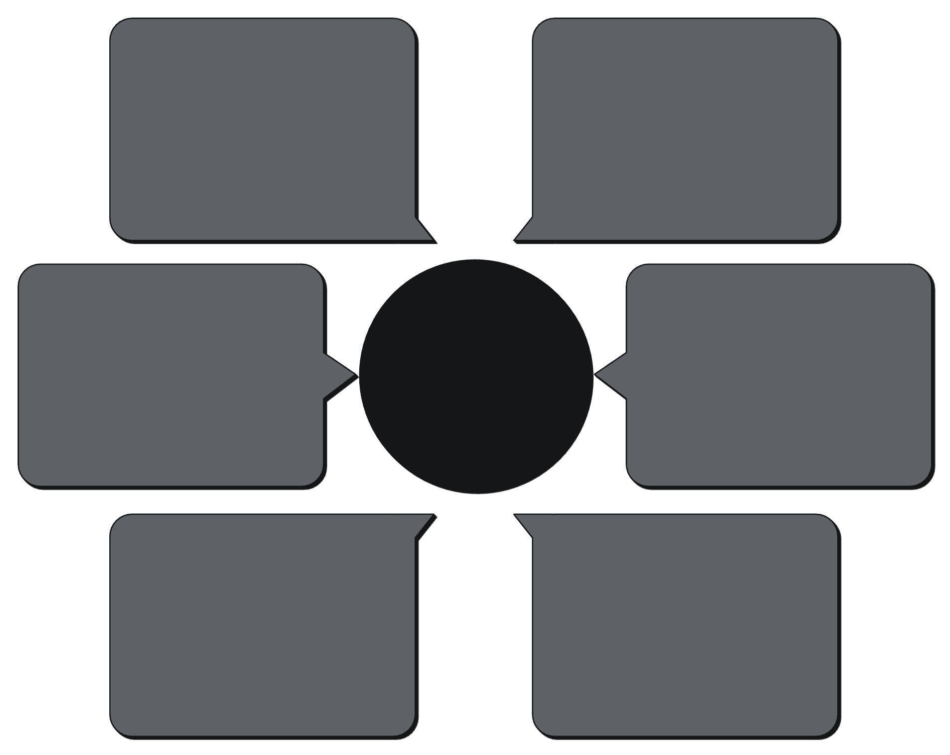
System Architecture: A Robust Foundation
Our system's architecture is designed for scalability, security, and efficiency, ensuring seamless delivery of educational content.
Patient Data Integration
User Interfaces
EMR and device sync
Web and mobile access
AI Chatbot Service
Automated Patient Education System
API Gateway
Personalized education
Central request routing
Content Management
Authentication Service
Authoring and updates
Secure user validation
This modular approach allows for easy updates, maintenance, and future expansion, adapting to evolving healthcare needs and technological advancements.

Slide 14





Solutions: Addressing Key Healthcare Pain Points
Knowledge Gap
Low Adherence
Provides clear, concise, and accessible medical information, breaking down complex topics into understandable segments.
Personalised reminders, interactive guides, and progress tracking encourage consistent adherence to treatment plans.
High Costs
Communication Barriers
Reduces the burden on healthcare staff and prevents complications, leading to a decrease in overall healthcare expenditures.
Multilingual support and a friendly chatbot overcome language and literacy barriers, fostering better patient-provider dialogue.

Slide 15

Project Roadmap: Phased Implementation for Success
Phase 1: Foundation & Alpha Launch
1
Develop core platform, implement basic chatbot functionality, and launch an alpha version with a select group of users for feedback.
2
Phase 2: Feature Expansion & Beta
Integrate visual learning aids, introduce personalised learning paths, and expand to a broader beta user base.
Phase 3: Integration & Official Launch
3
Full integration with patient portals, advanced analytics, and official nationwide launch.
4
Phase 4: Continuous Improvement
Regular content updates, AI model refinement, new feature development, and partnership expansion.

Slide 16


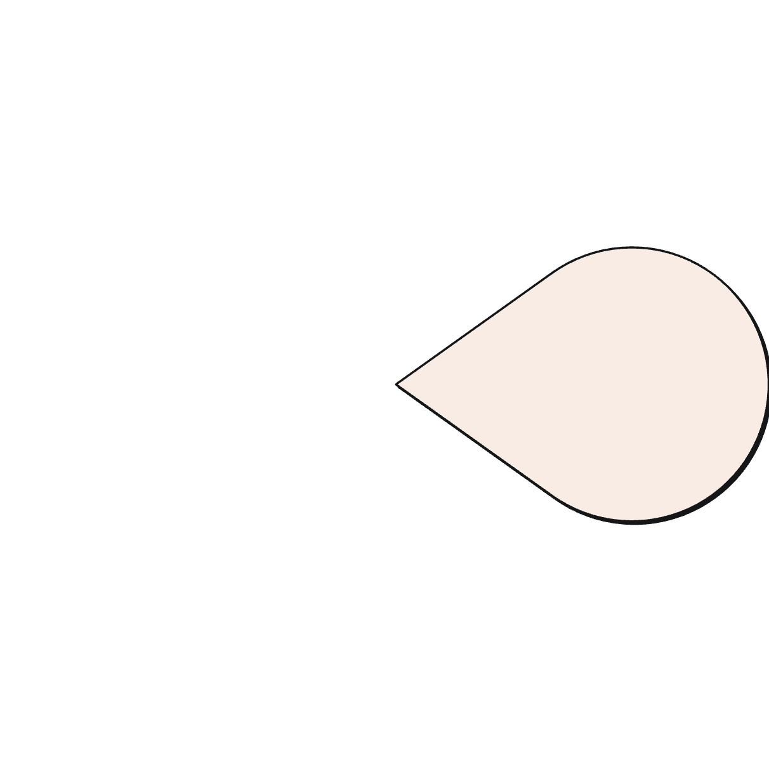







Conclusion: A Brighter Future for Patient Education in India
Improved Outcomes
Empowered Patients
Better understanding leads to better health results.
Knowledgeable patients are active participants in their health.
Efficient Healthcare
Streamlined processes benefit both patients and providers.
Future-Ready System
Continuously evolving with technology and patient needs.
Accessible Information
Health literacy for everyone, everywhere in India.
The Automated Patient Education System is more than just a tool; it's a commitment to a healthier, more informed India. By leveraging technology, we can empower every patient to take control of their health journey.

